Slide 1
Improving the love-hate relationship between devs and QA
...or how to hate devs/QA a little less...

Slide 2
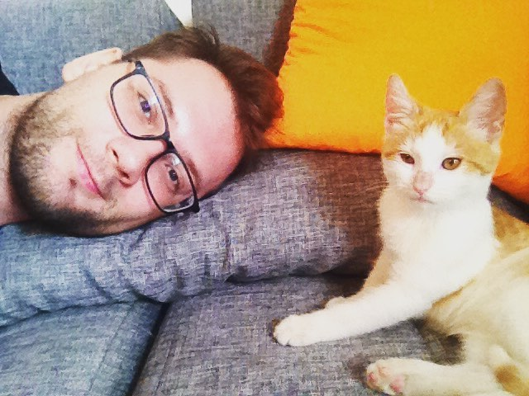
Who am I
Software Developer @ Degordian
PHP & JS enthusiast
I also like Typescript.
Background in everything.
Not a tester. Nor a QA.
I have a cat. And cat allergies.

Slide 3
Love-hate between devs and QA

Slide 4

Love-hate between devs and QA

Slide 5

Love-hate between devs and QA

Slide 6
My day…

Slide 7

My day…

Slide 8

My day…

Slide 9
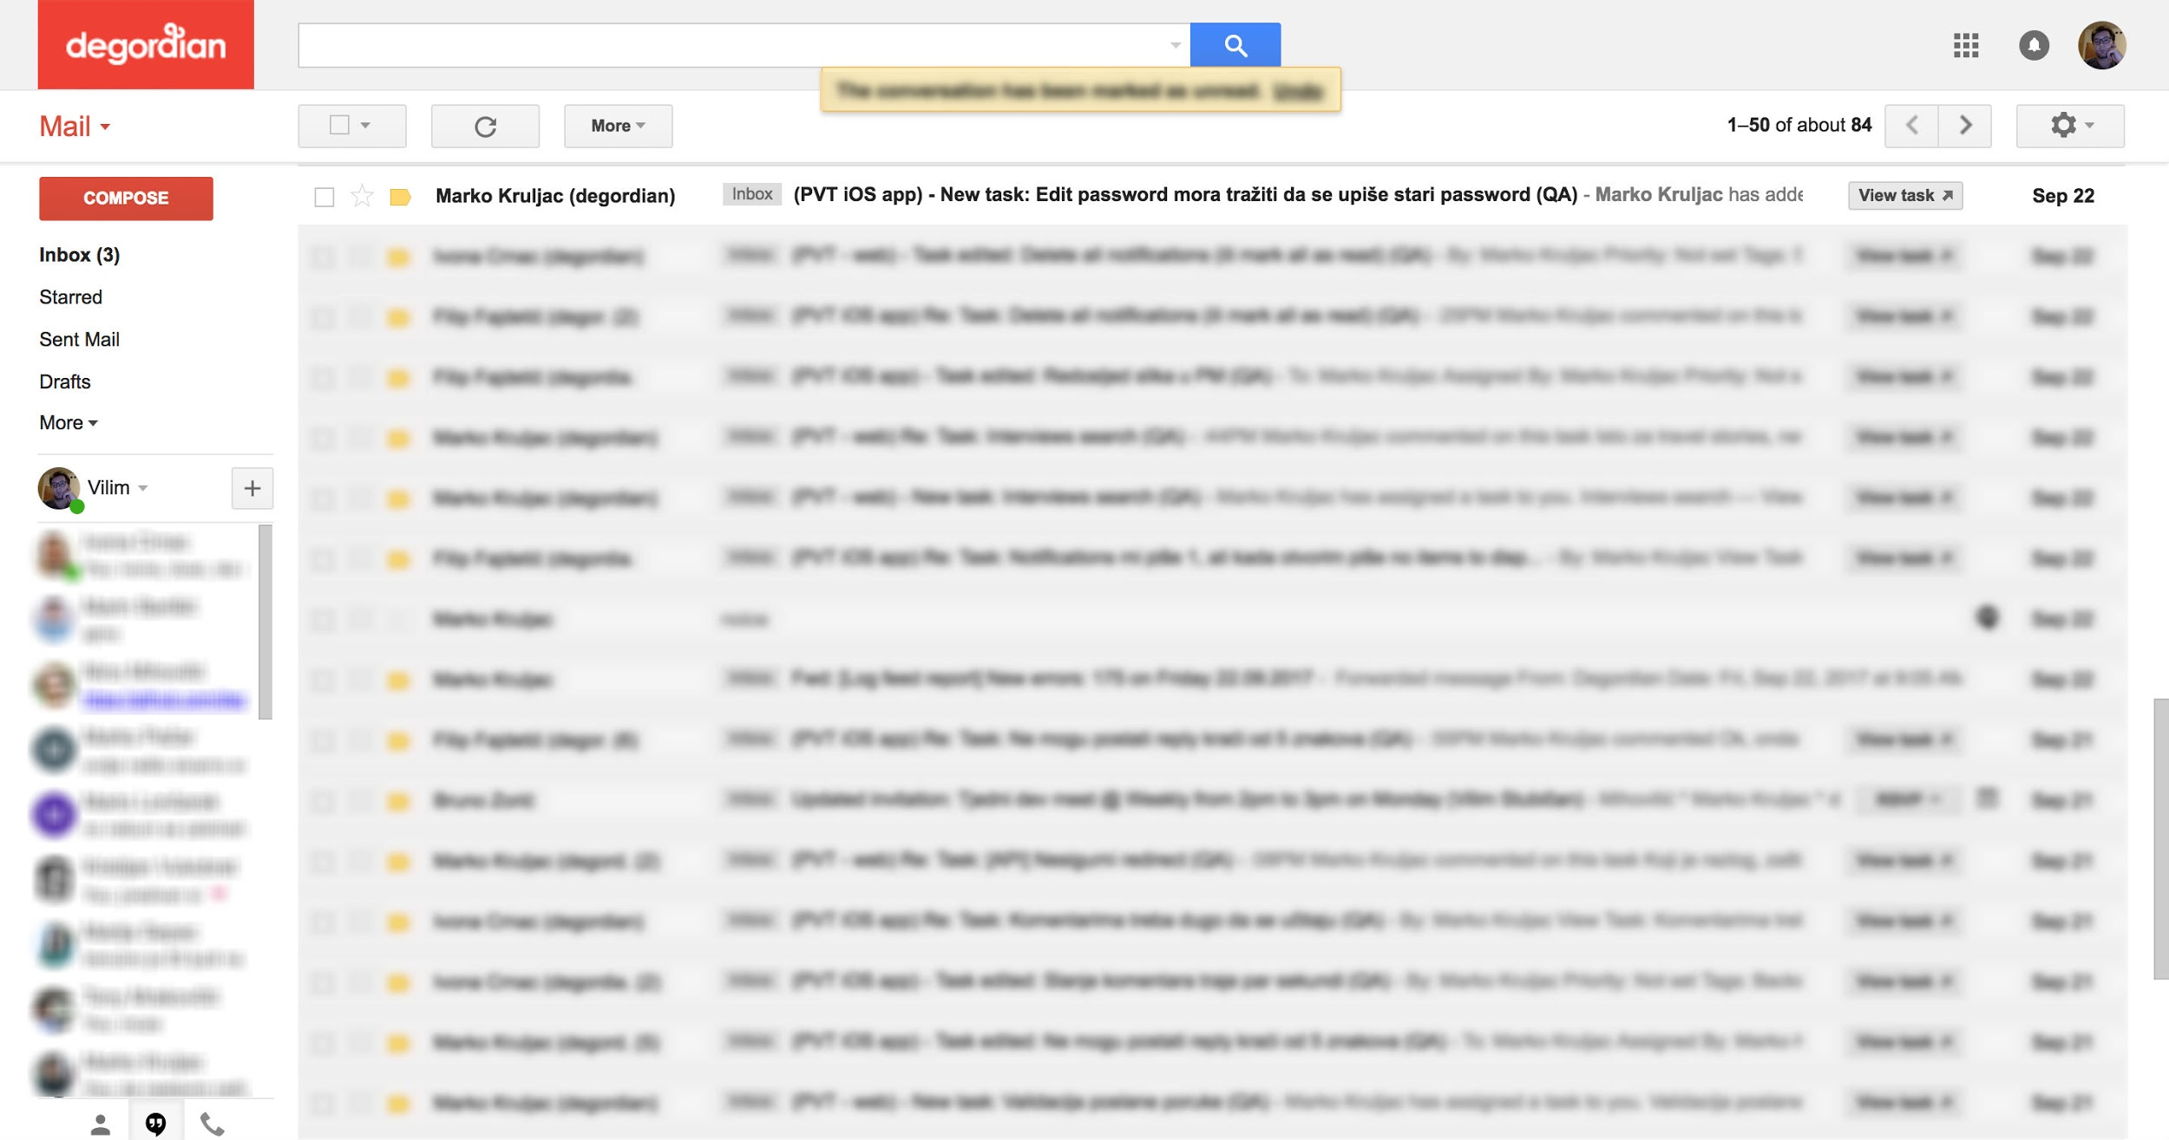
My day…

Slide 10
My day…

Slide 11

My day…

Slide 12

6 commandments for life with QA

Slide 13
Have mutual respect
Treat each others as friends and professional colleagues
Find the silver lining
Offer that olive branch

Slide 14
2. Don’t be enemies
You are working towards the same goals
It is not you versus them
Step over your egos

Slide 15
3. Find out the goal of testing
Talk to QA/dev about the problem you are encountering
You wouldn’t take a test in school without knowing what you are going to be tested on first

Slide 16
4. Do your job yourself
Mostly for devs and mostly for doing a large part of testing themselves
QA is not a babysitter, it is last line of defense before the true enemy
those would be clients :)
Avoid bug/fix cycle

Slide 17
5. Help each other out
Learn from each other
Solve problems together by using variety of skills you both have

Slide 18
6. Give credit where credit is due
Small and sincere compliment can go a long way
Bring cookies :)

Slide 19

What about those a**hats?
They can always be present
Try one of these:
count to 10
point finger at yourself
keep it professional

Slide 20
Conclusion

Slide 21

Conclusion

Slide 22

Conclusion

Slide 23
Thank You!
Q&A?

